Slide 1
21
Credit and Inventory Management

Slide 2

Chapter 21 – Index of Sample Problems
Slide # 02 - 03 Accounts receivable
Slide # 04 - 06 Discount terms
Slide # 07 - 09 Credit policy switch
Slide # 10 - 11 Switch break-even point
Slide # 12 - 13 One-time sale
Slide # 14 - 15 Repeat sale
Slide # 16 - 21 Economic order quantity (EOQ)
Slide # 22 - 25 One-shot approach
Slide # 26 - 27 Accounts receivable approach
Slide # 28 - 30 Discounts and default risk

Slide 3
2: Accounts receivable
Over the past five years, your firm has had average daily sales of $26,780. The average collection period is 34 days.
What is the average accounts receivable balance you would expect to find if you analyzed the monthly balance sheets of your firm?

Slide 4
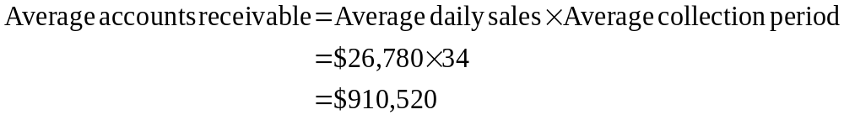
3: Accounts receivable

Slide 5
4: Discount terms
Today, June 10, you purchased $5,000 worth of materials from one of your suppliers. The terms of the sale are 3/15, net 45.
What is the discounted price?
By what day do you have to pay to receive the discount?
What is the effective annual rate of the discount?

Slide 6
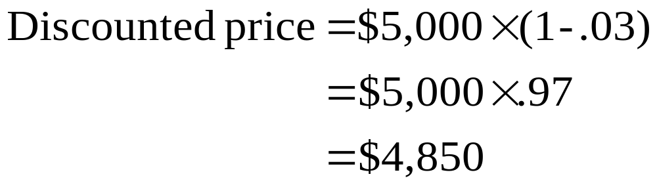
5: Discount terms

Slide 7

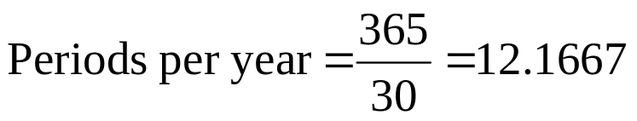
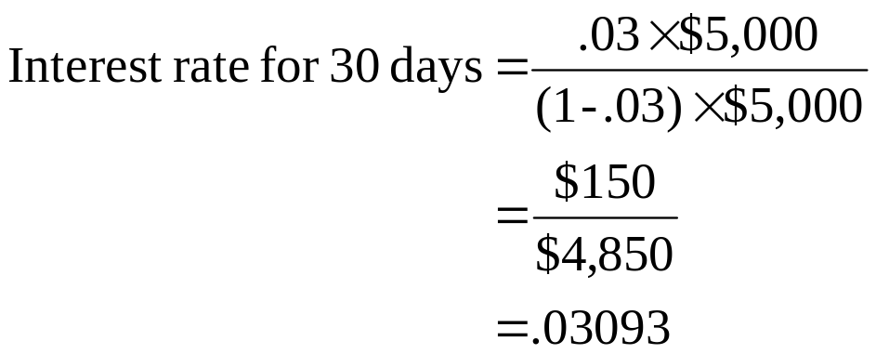
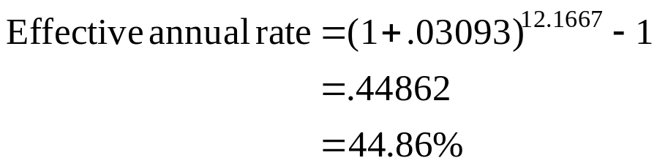
6: Discount terms

Slide 8
7: Credit policy switch
Currently, your firm has a cash only policy. Under this policy, your monthly sales are 70 units at a selling price of $50 a unit. The variable cost is $34 a unit. You are trying to decide if you want to change your credit policy to net 30. You estimate that if you switch your credit policy that your monthly sales will increase to 90 units. The applicable monthly interest rate is .5%.
What is the incremental cash inflow from the proposed switch in your credit policy?
What is the net present value of the proposed switch?

Slide 9
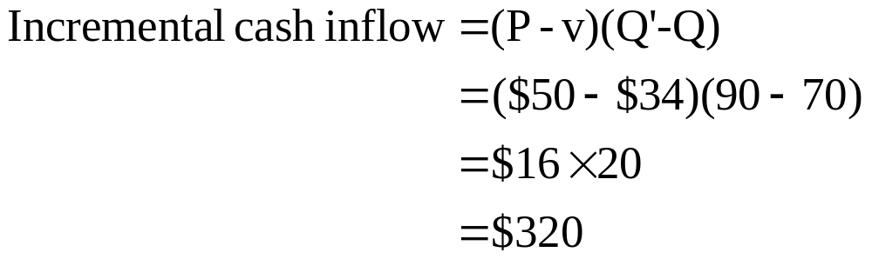
8: Credit policy switch

Slide 10
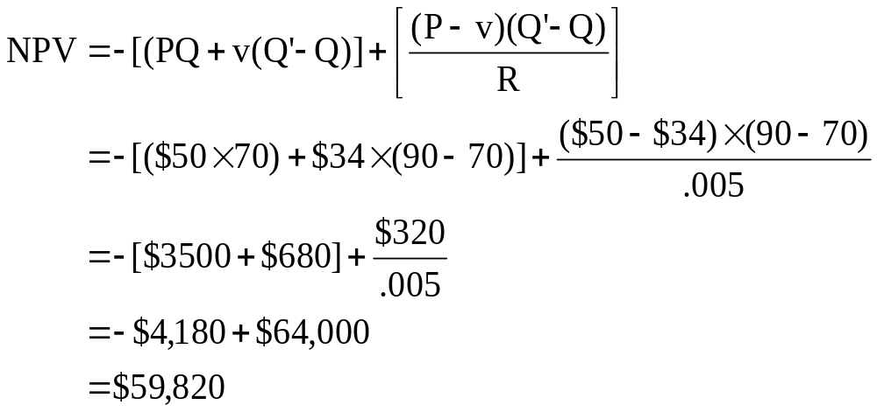
9: Credit policy switch

Slide 11
10: Switch break-even point
Your brother owns a company that also has a cash only credit policy. He, too, is considering switching to a net 30 credit policy. His current sales per month are 85 units at an average selling price of $60 a unit. His variable cost is $42 a unit. His applicable monthly interest rate is 1.5%.
Your brother wants to know how many additional units he would have to sell to break-even on this proposed credit policy switch. What should you tell him?

Slide 12
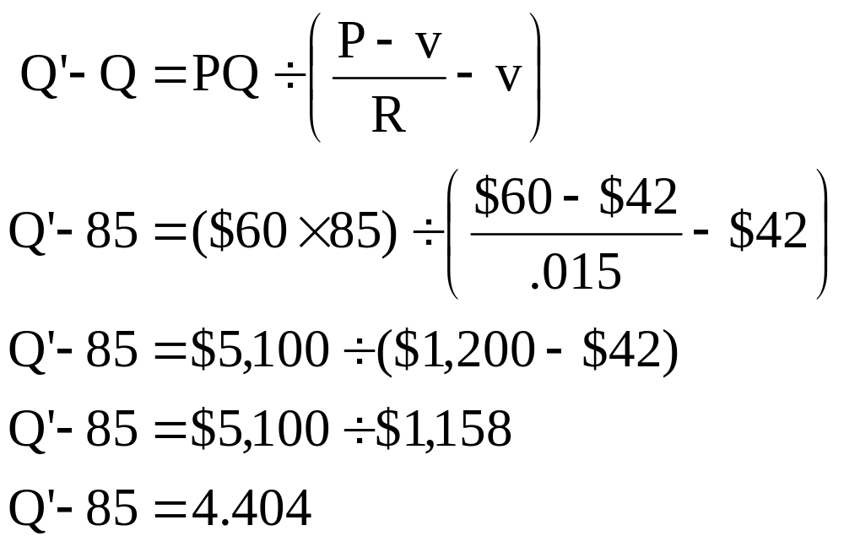
11: Switch break-even point

Slide 13
12: One-time sale
A customer just walked into your store and wants to buy some electronics costing $89. The customer states that he is from out of town and is just passing through on an extended vacation. Thus, you know that this is a one-time sale. Your variable cost for this merchandise is $50 and your relevant interest rate is 1.5% per month. Since this customer had not planned on making this purchase, he does not have sufficient funds with him to pay for it and thus asks for credit for one month until he arrives back home.
Should you grant credit to this customer if you feel there is a 30% chance that he will default?

Slide 14
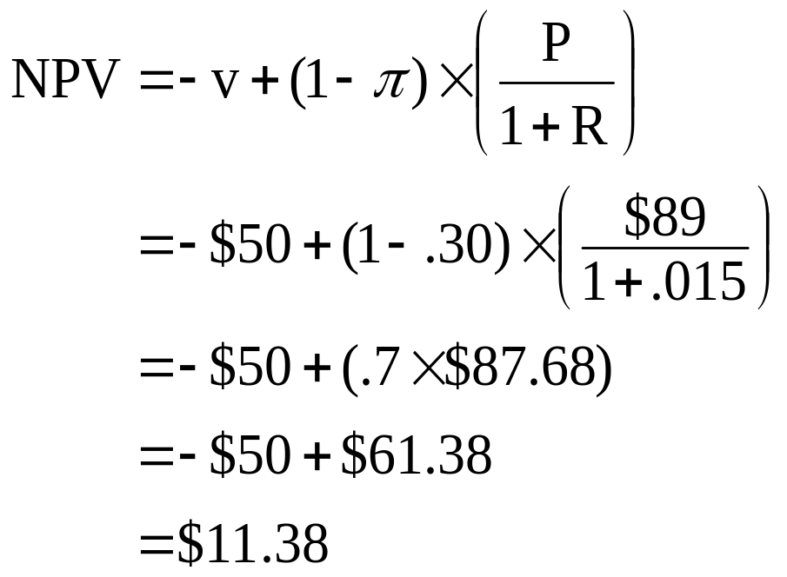
13: One-time sale

Slide 15
14: Repeat sale
A new customer just walked into your store. She says that she is new to the area and is out checking out the various retail stores to decide where she will shop in the future. She’s looking at some merchandise costing $250 but states that she won’t have that much money until next month. You know that your variable cost in the item is $180 and that your monthly interest rate is 1.7%.
Should you offer her credit for one month if you feel that the chance of default is 10%?

Slide 16
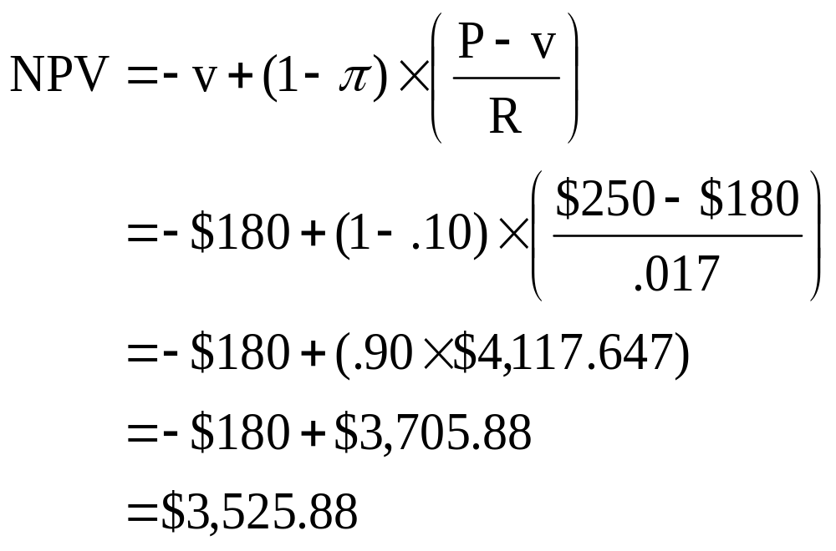
15: Repeat sale

Slide 17
16: Economic Order Quantity (EOQ)
You have just accepted a job as the purchasing manager for a local retailer. You have identified one key item that you believe needs close monitoring. You’ve been told that your store sells 31,200 units of this item each year. The fixed costs per order are $75. The carrying cost per unit is $1.10.
What is the economic order quantity?

Slide 18
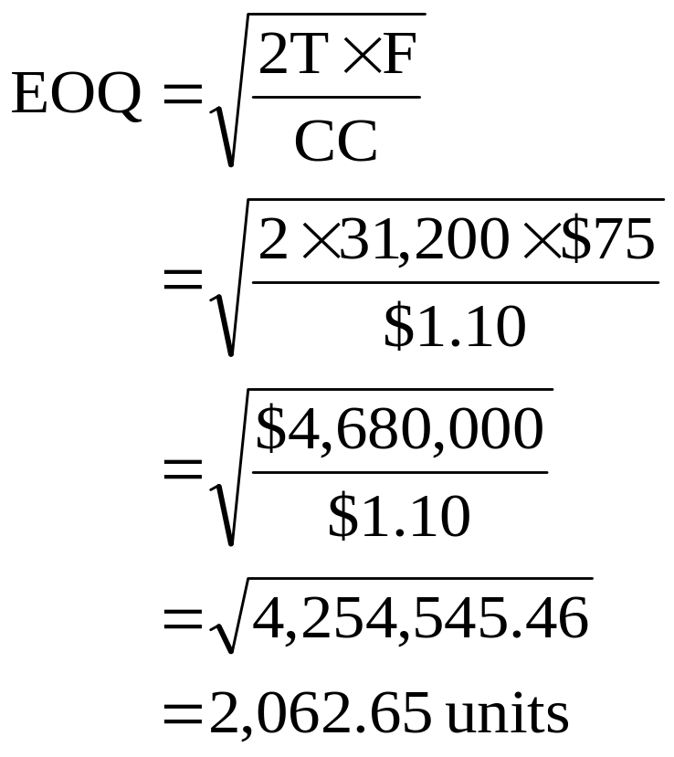
17: Economic Order Quantity (EOQ)

Slide 19
18: Economic Order Quantity (EOQ)
You sell 12,000 units of a product each year at an average price of $15 each. Your variable cost per unit is $9. Your carrying cost per unit is $.60. You allow your inventory of this product to drop to zero before restocking. Each order you place is for 2,500 units. The fixed cost per order is $40.
What is your annual total carrying cost?
What is your annual total restocking cost?
What is the EOQ?

Slide 20
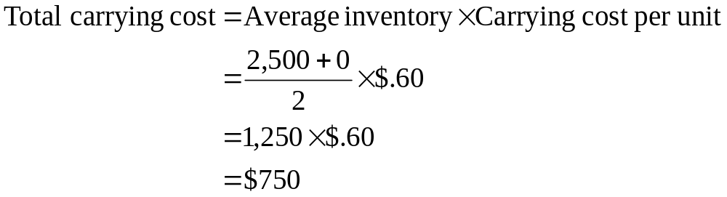
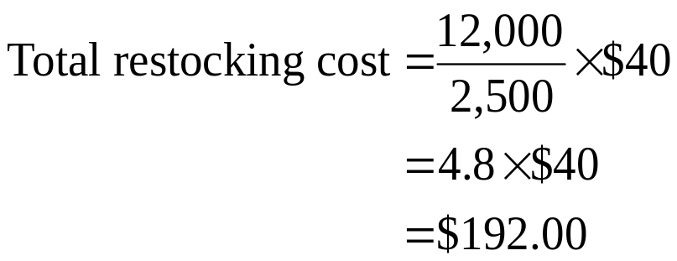
19: Economic Order Quantity (EOQ)

Slide 21
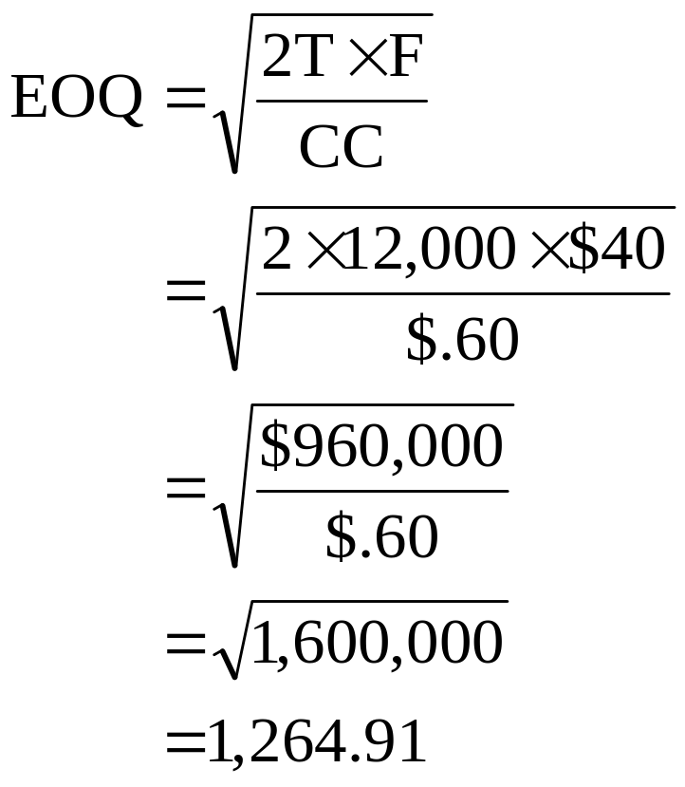
20: Economic Order Quantity (EOQ)

Slide 22
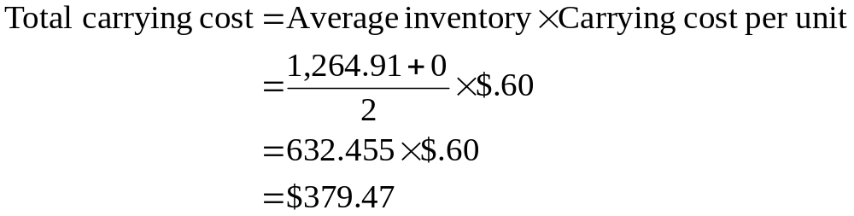
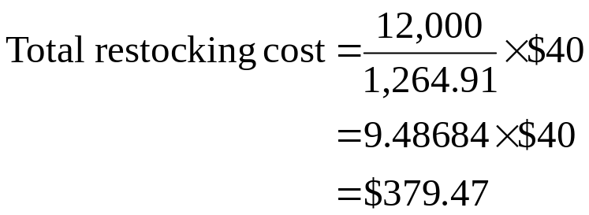
21: Economic Order Quantity (EOQ)

Slide 23
22: One-shot approach
Your firm currently sells 200 units each month at a price of $24 each. The variable cost per unit is $14 and the monthly interest rate is 1.5%. If you switch your credit policy from cash only to net 30, you think you can increase your sales to 215 units a month.
Use the one-shot approach to compute the NPV of the switch.

Slide 24
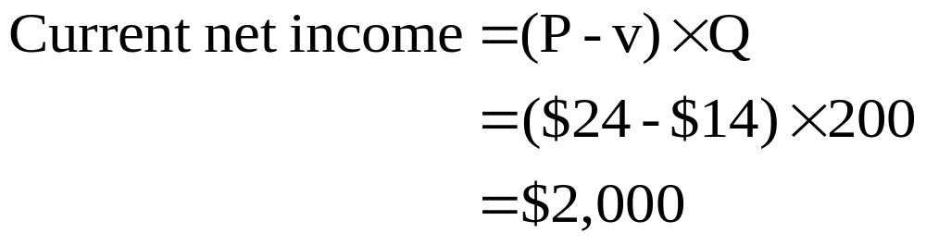
23: One-shot approach

Slide 25
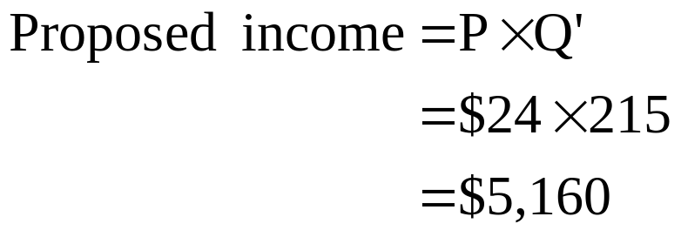
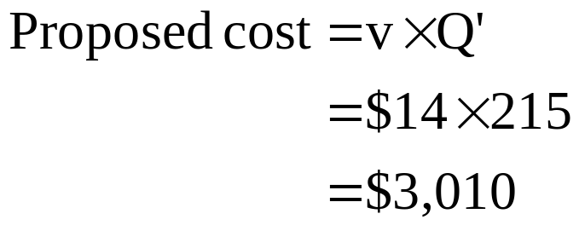
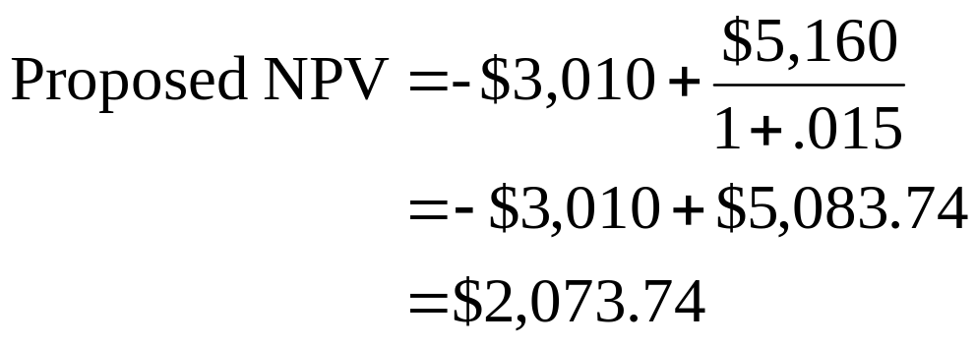
24: One-shot approach

Slide 26
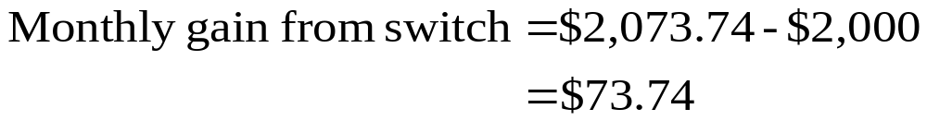
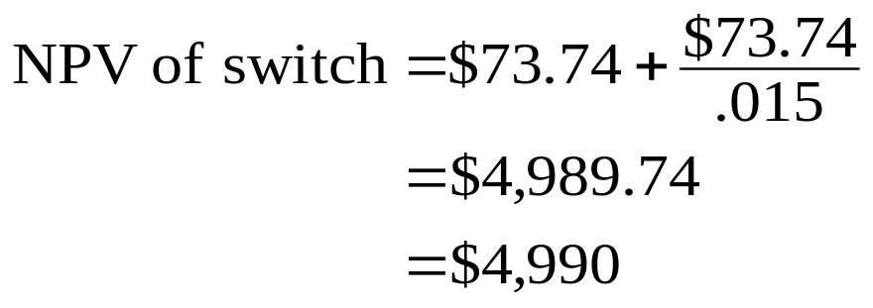
25: One-shot approach

Slide 27
26: Accounts receivable approach
Your firm currently sells 200 units each month at a price of $24 each. The variable cost per unit is $14 and the monthly interest rate is 1.5%. If you switch your credit policy from cash only to net 30, you think you can increase your sales to 215 units a month.
Use the accounts receivables approach to compute the NPV of the switch.

Slide 28
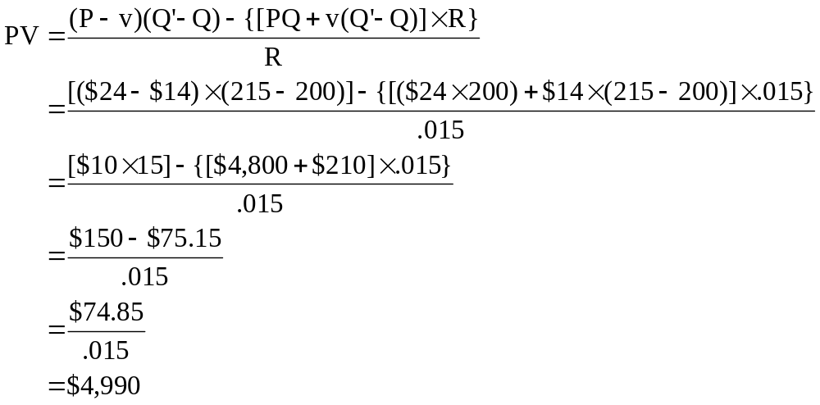
27: Accounts receivable approach

Slide 29
28: Discounts and default risk
Currently, you sell 50 units per period at $22.50 a unit. You are considering implementing a net 30 credit policy along with increasing your credit price to $24. If you make this change, you expect that your sales will remain at their current level. You also expect all of your customers to take advantage of the credit period and that 2% of them will default. The applicable monthly interest rate is 1.5%.
What is the net present value of this proposed credit policy?
What is the break-even default rate?

Slide 30
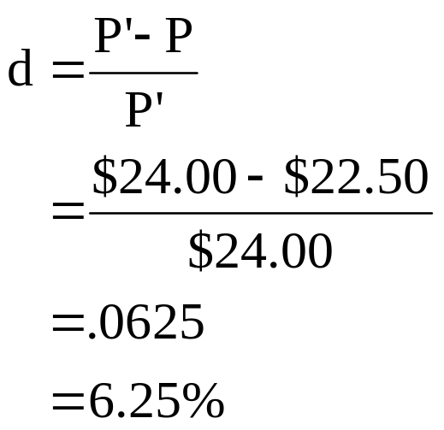
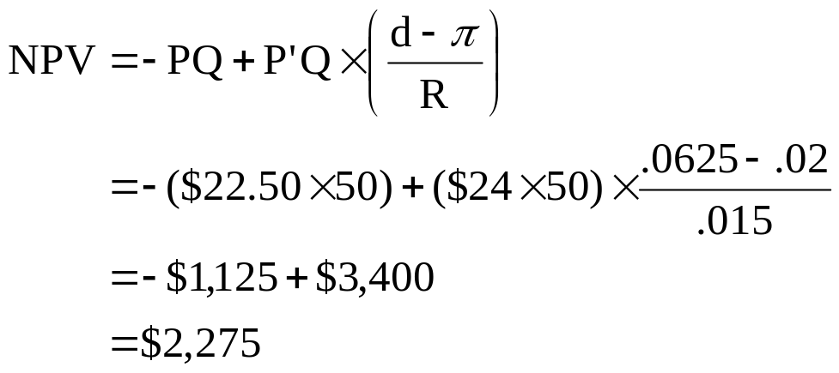
29: Discounts and default risk

Slide 31
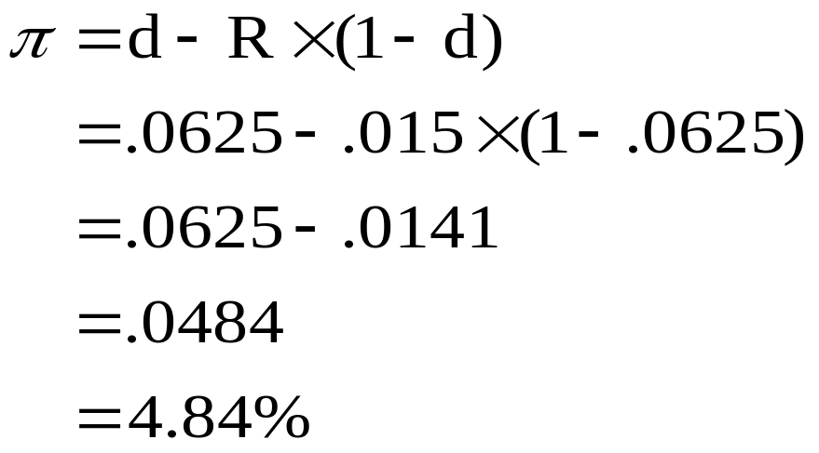
30: Discounts and default risk

Slide 32
21
End of Chapter 21

